Slide 1

Air Lines Loyalty Analysis Presentation

Slide 2

The Business Power Of Air Line Programs
From a commercial perspective, airline loyalty programs have transcended their original role as tools to attract repeat customers—they’ve become strategic financial assets that generate substantial revenue and directly influence pricing and expansion decisions.
Notes:
This slide discusses the business context surrounding airlines' loyalty programs. The industry is witnessing a rapid recovery as travel resumes post-pandemic, along with heightened competition in frequent flyer rewards. Customer behavior is shifting towards valuing flexibility, upgrades, and diverse rewards beyond flights. The analysis presented focuses on loyalty transactions over a three-year span across key states, examining redemption patterns and their impact on revenue.

Slide 3

Financial Value
Airlines sell miles to partners like banks and insurance companies, providing steady income—even during downturns in travel.
Programs such as AAdvantage and SkyMiles are valued in the billions and, in some cases, exceed the worth of the airline itself.

Slide 4

Data-Driven Strategy & Dynamic Pricing
Carriers leverage loyalty data to understand traveler behavior and personalize offers.
Ticket pricing and rewards are dynamically adjusted based on demand, enhancing profitability and minimizing unsold seats.

Slide 5
Partner Ecosystems
Loyalty programs have expanded to include hotels, car rentals, and retail brands—giving customers more opportunities to earn points beyond flights.
This expansion boosts both engagement and the perceived value of the rewards.

Slide 6

Competitive Edge
- In a saturated market, a strong loyalty program can be the deciding factor in a traveler’s airline choice.
- Elite members receive exclusive benefits that strengthen their attachment to the brand and improve retention rates.

Slide 7
Business Context – Airlines Loyalty
Increased competition in frequent flyer rewards.
Customer Behavior: Flexibility and upgrades prioritized.
Analysis covers loyalty transactions from 2017-2018.
Links to booking data and customer segments.
Notes:
This slide discusses the business context surrounding airlines' loyalty programs. The industry is witnessing a rapid recovery as travel resumes post-pandemic, along with heightened competition in frequent flyer rewards. Customer behavior is shifting towards valuing flexibility, upgrades, and diverse rewards beyond flights. The analysis presented focuses on loyalty transactions over a three-year span across key states, examining redemption patterns and their impact on revenue.

Slide 8

Objectives – Loyalty Insights
Understand how members contribute to revenue and flight utilization.
Identify which loyalty tiers and redemption types perform the best.
Detect churn risks caused by inactivity and downgrade trends.
Recommend strategies to enhance loyalty engagement and ROI.
Notes:
This slide outlines the key objectives of our loyalty insights analysis. We aim to understand member contributions to revenue as well as how effectively they utilize flights. Additionally, we will delve into the performance of loyalty tiers, potential churn risks, and strategies for boosting engagement and return on investment.

Slide 9



Agenda
Agenda
Storing Data
Exploring
Transformation & Cleaning
Data Modeling
Data Analysis

Slide 10
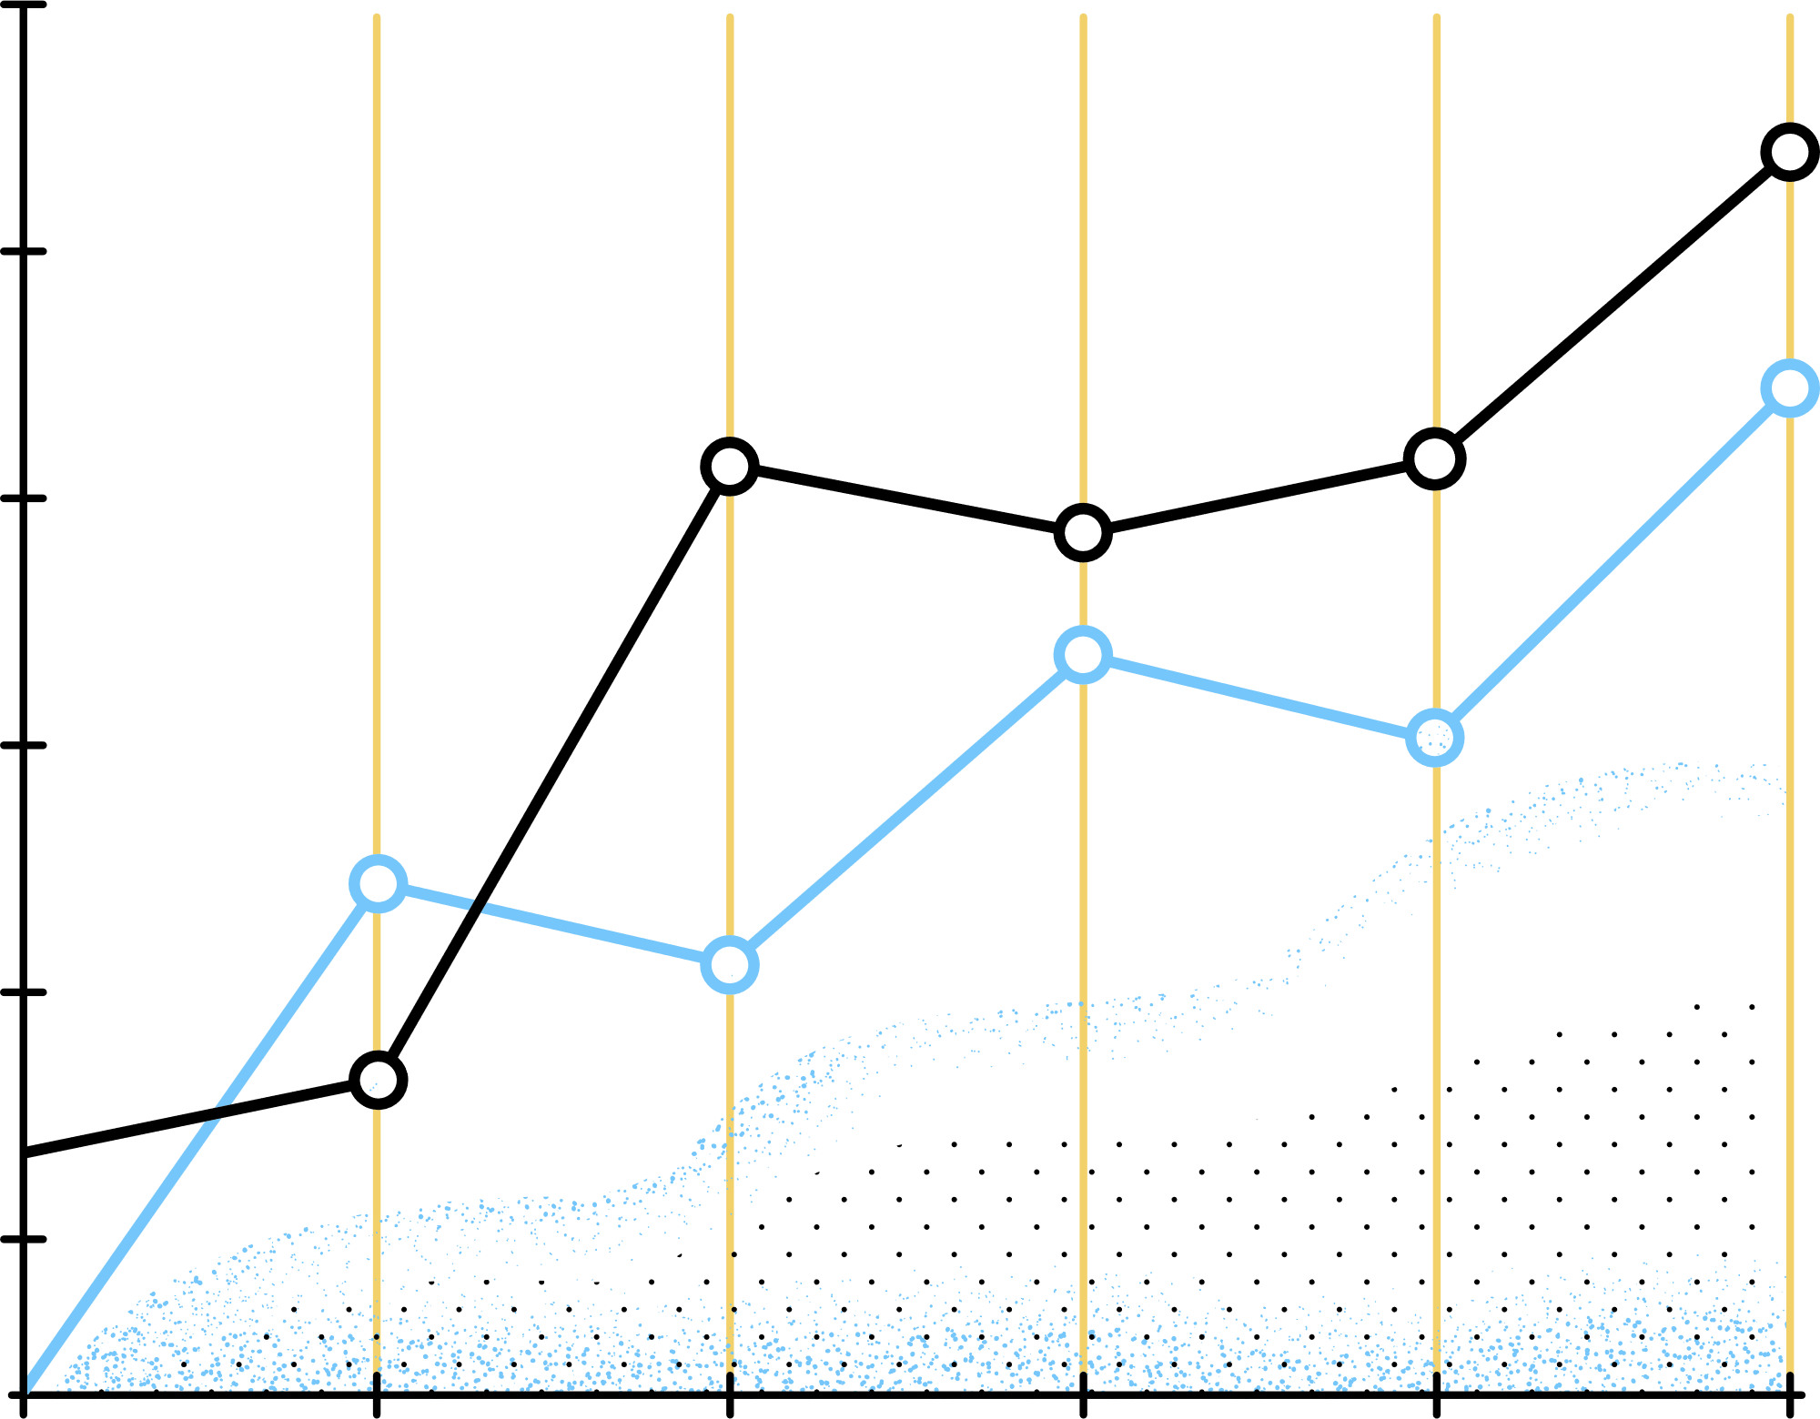
Storing Data
Designed a new database system.
Imported files into the database.
Tried to configure the appropriate mappings.
Extracted useful insights.

Slide 11
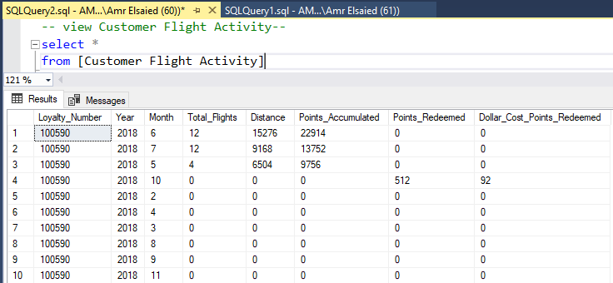

Slide 12
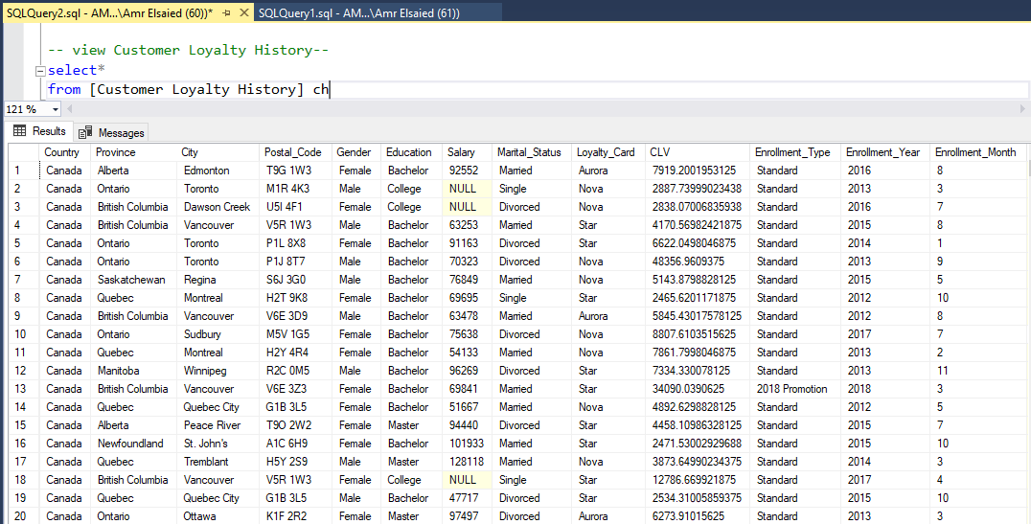

Slide 13
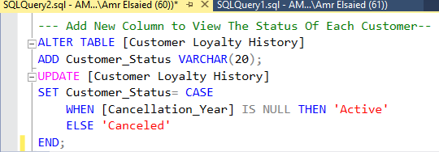
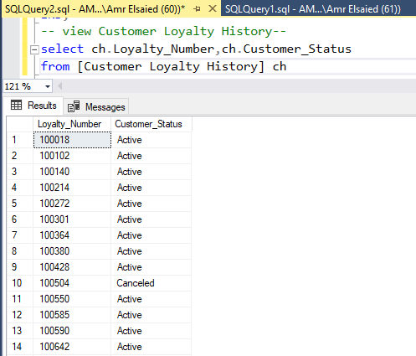
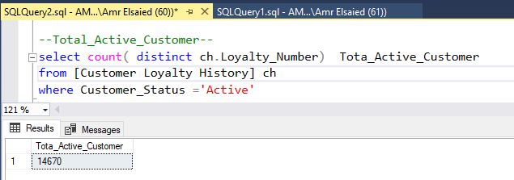

Slide 14
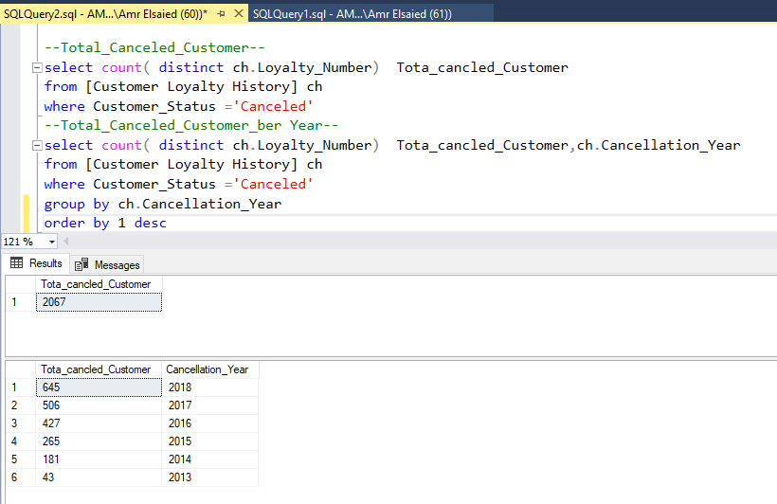

Slide 15
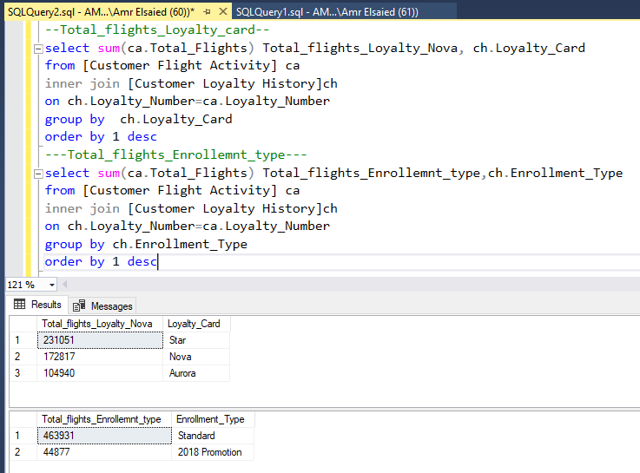

Slide 16
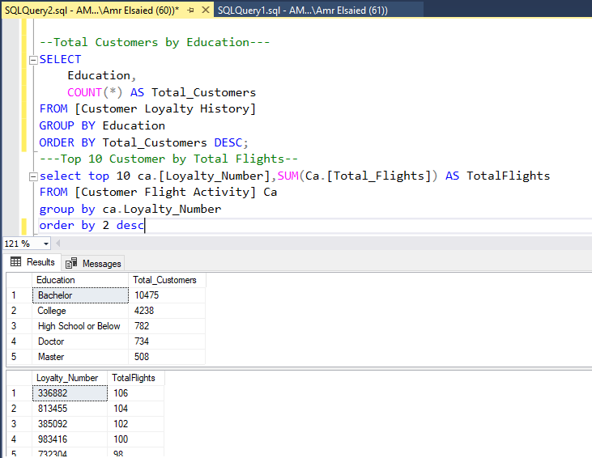

Slide 17
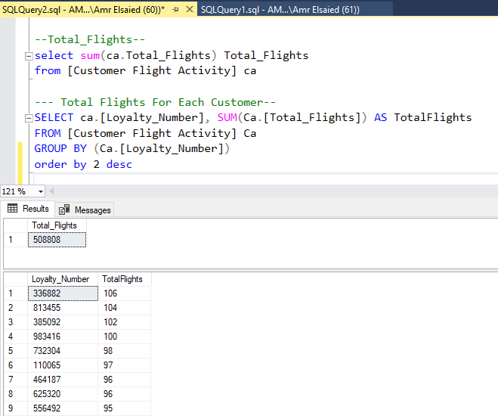

Slide 18
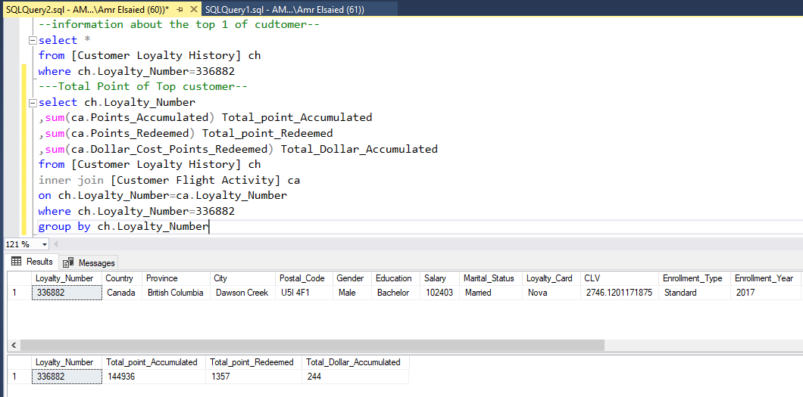

Slide 19
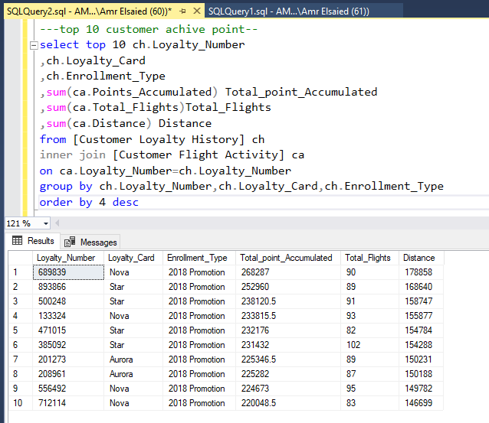

Slide 20
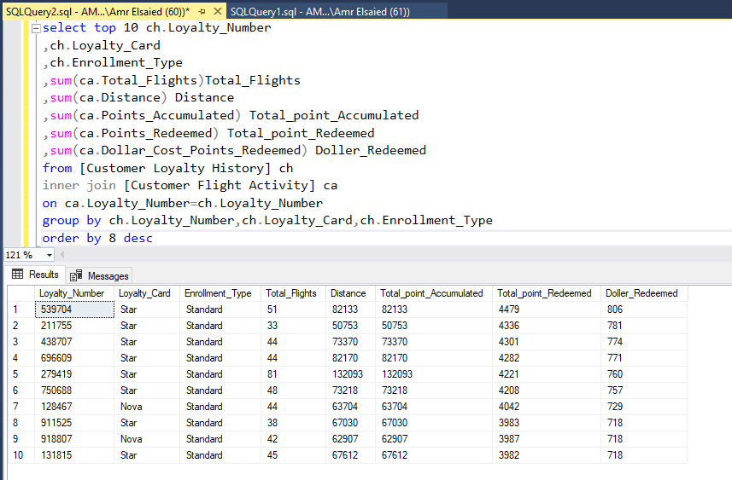

Slide 21
Exploring
Loading data
Exploring datasets
Combining data sources
Identify Outliers
Determining correlation coefficients

Slide 22
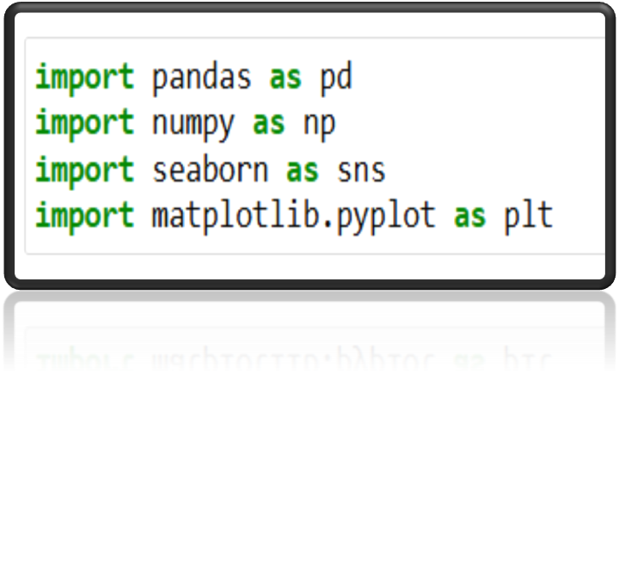
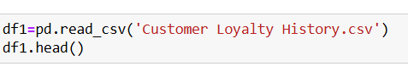

Slide 23
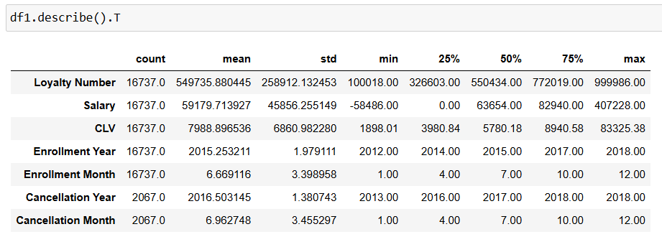
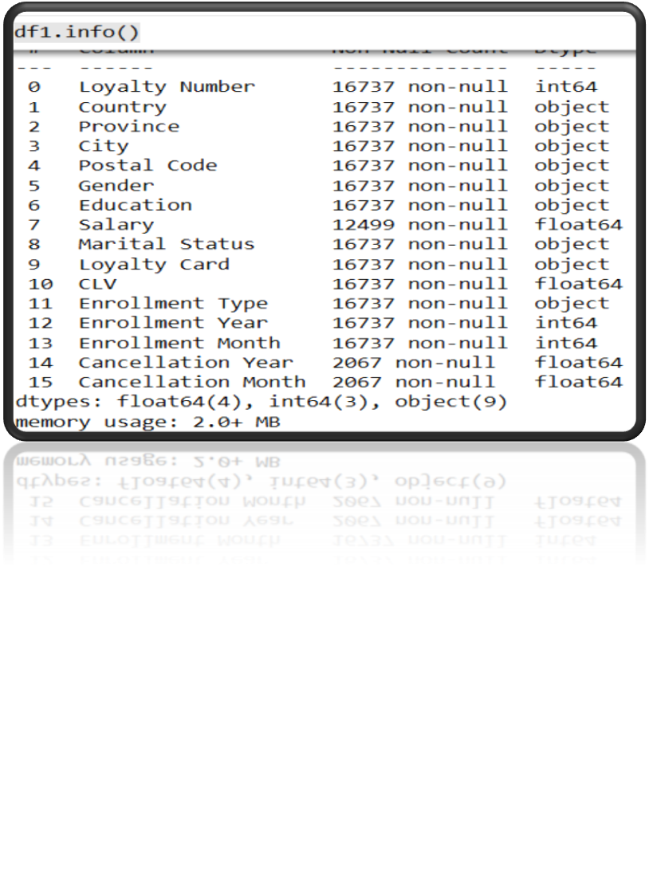

Slide 24
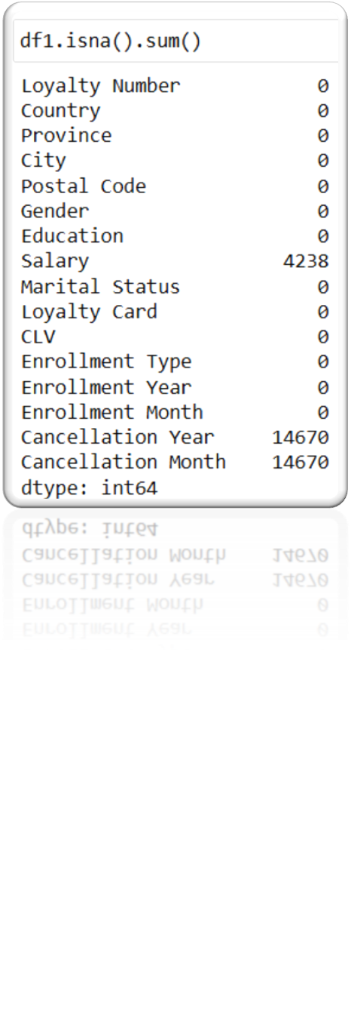
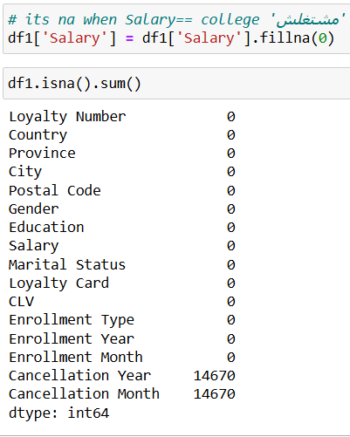

Slide 25
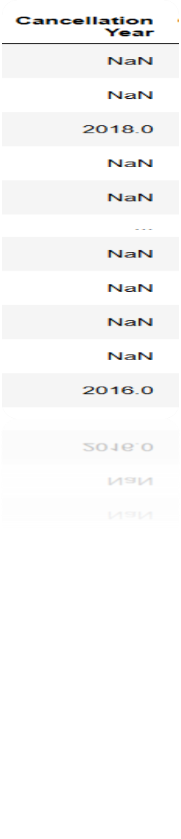

Slide 26
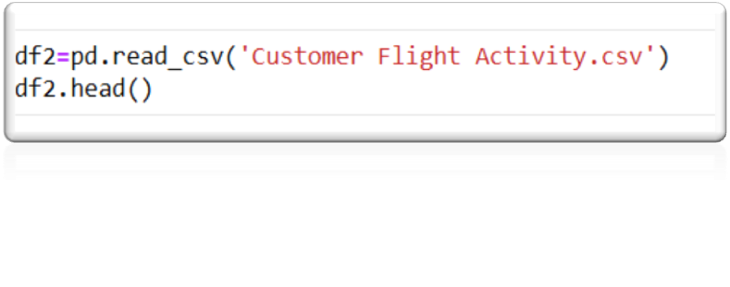
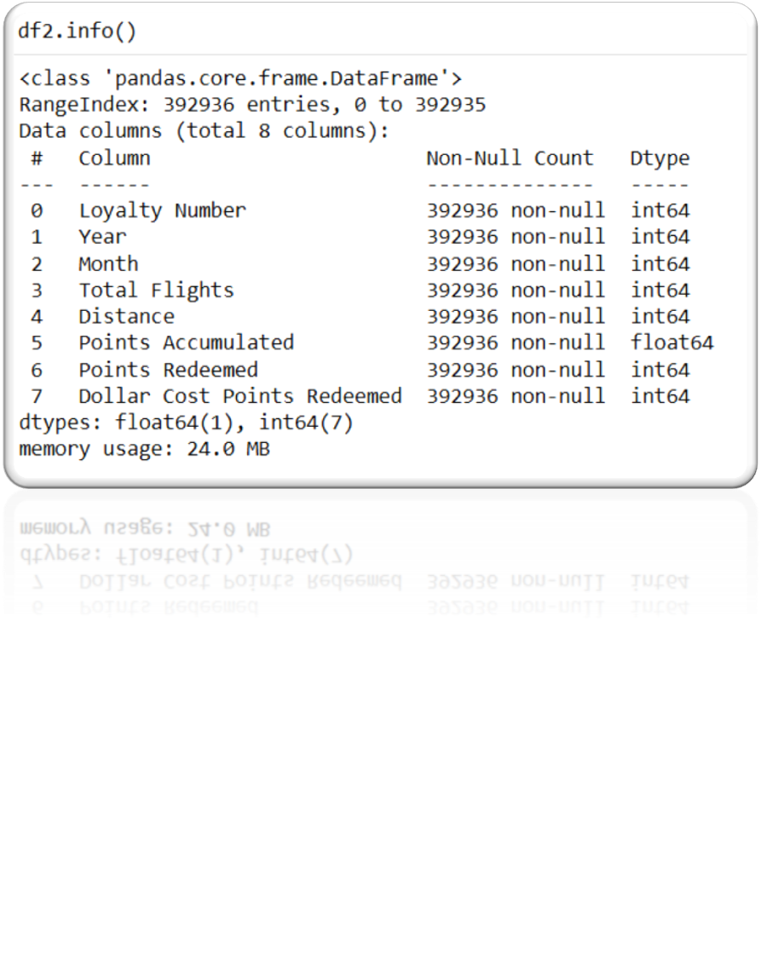

Slide 27
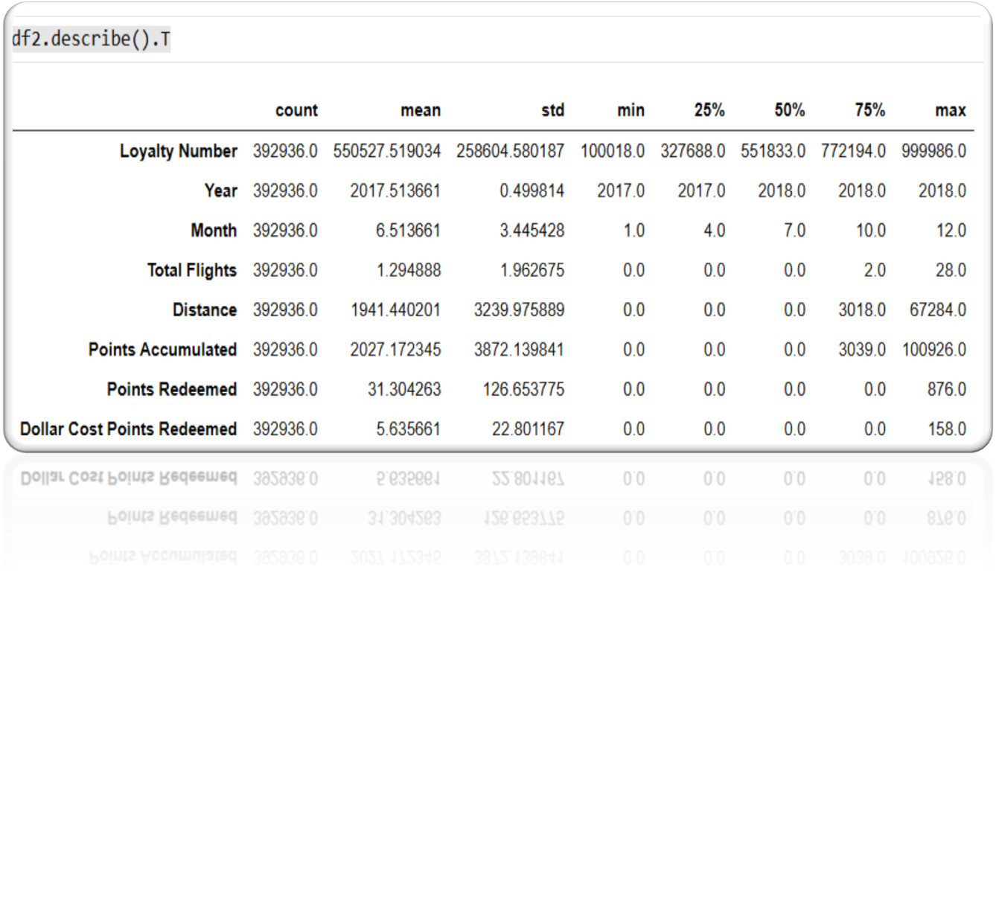
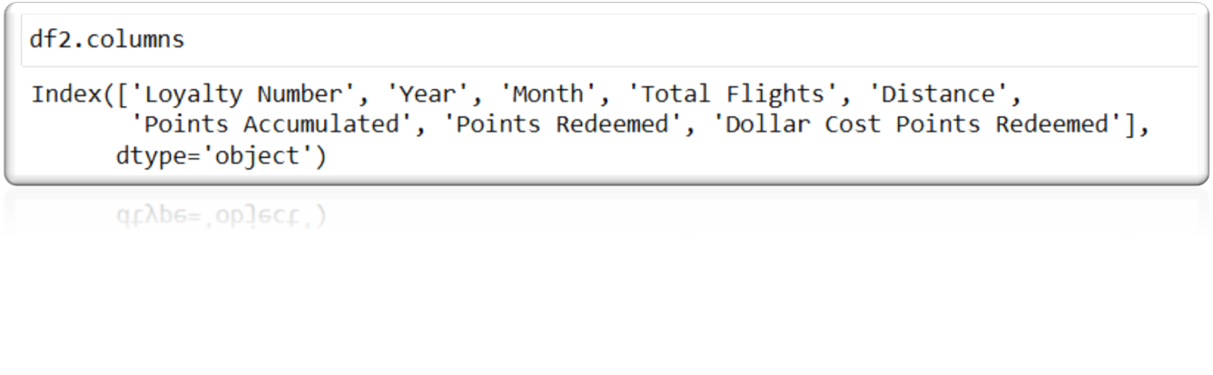

Slide 28
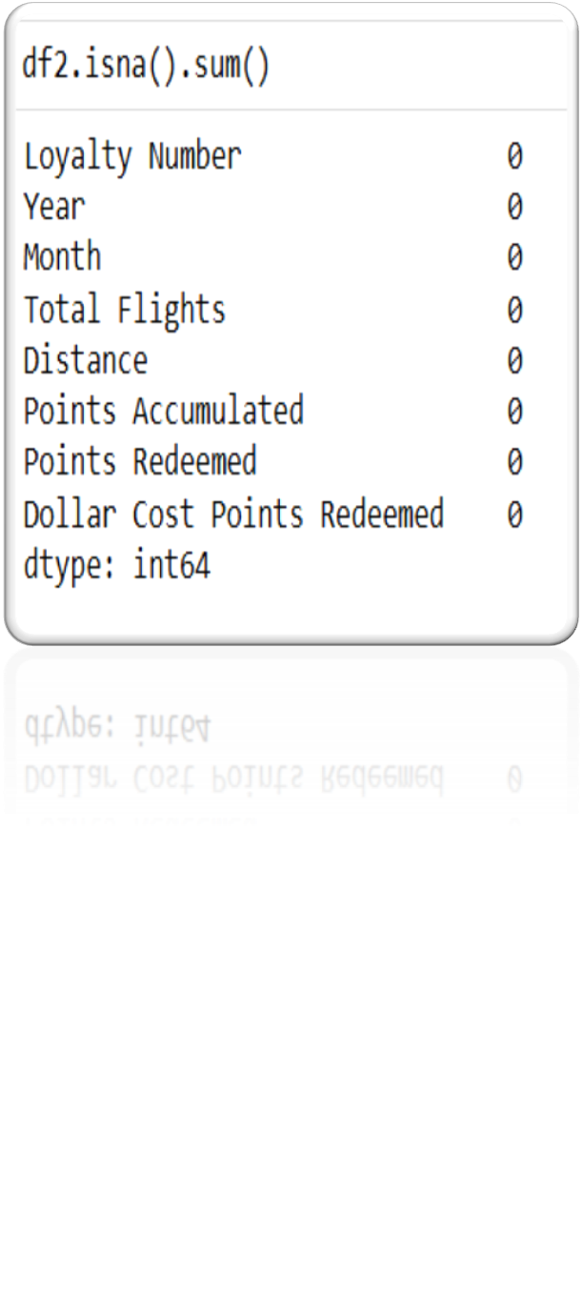
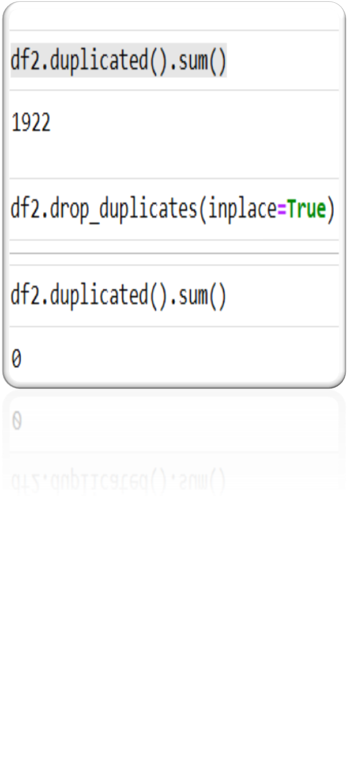

Slide 29
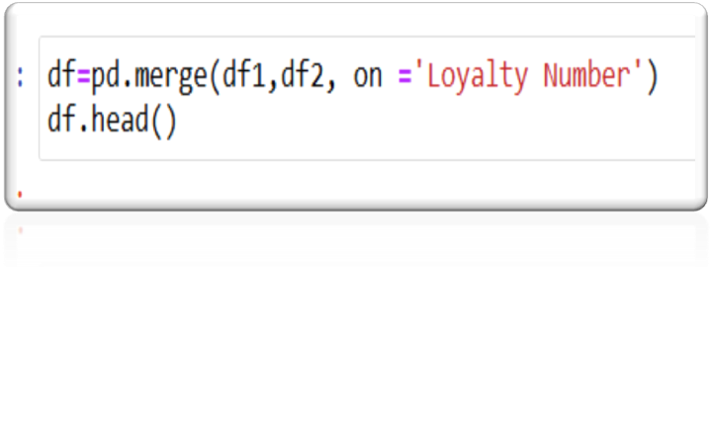
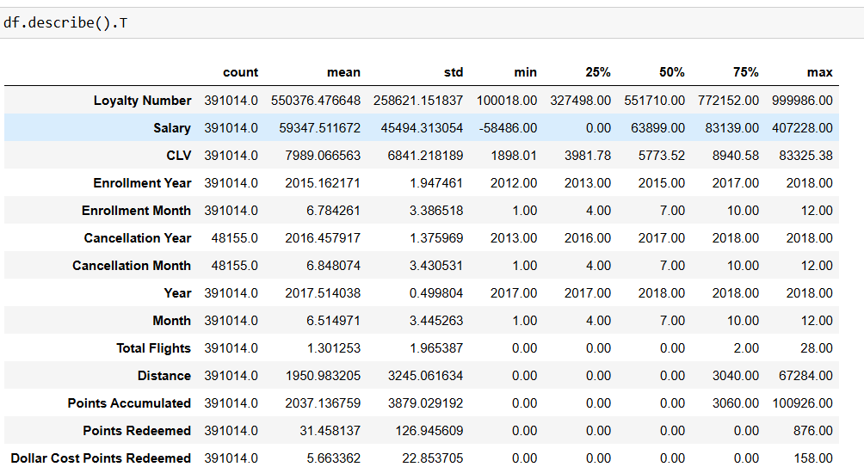

Slide 30
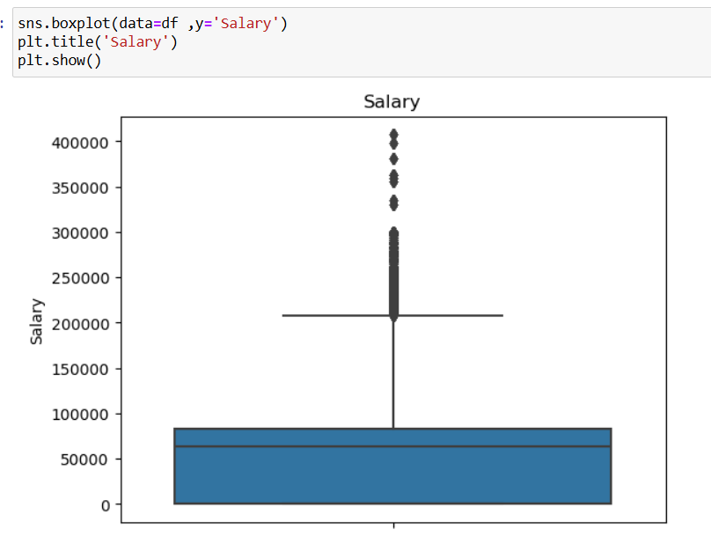

Slide 31
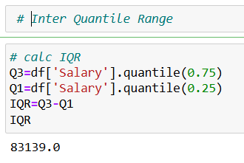
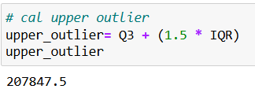
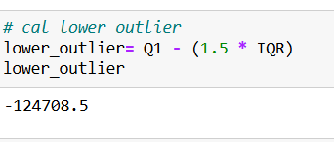

Slide 32
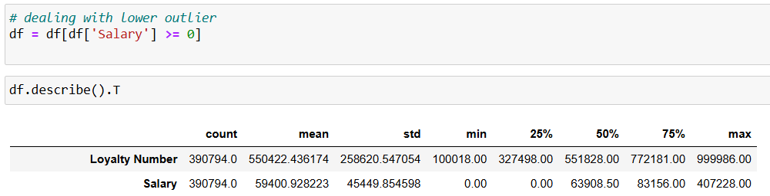

Slide 33
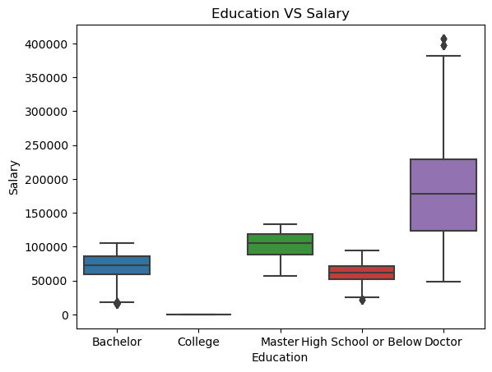
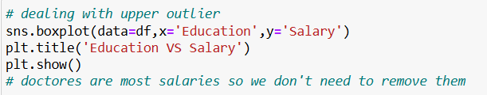

Slide 34
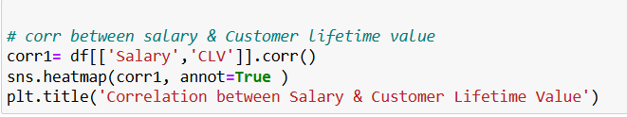
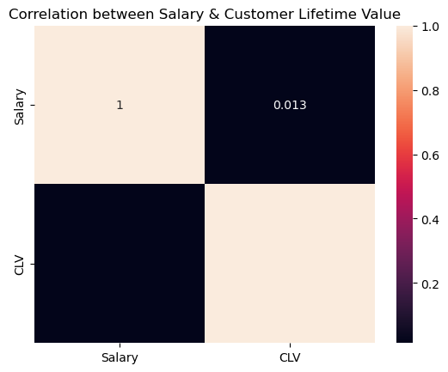

Slide 35
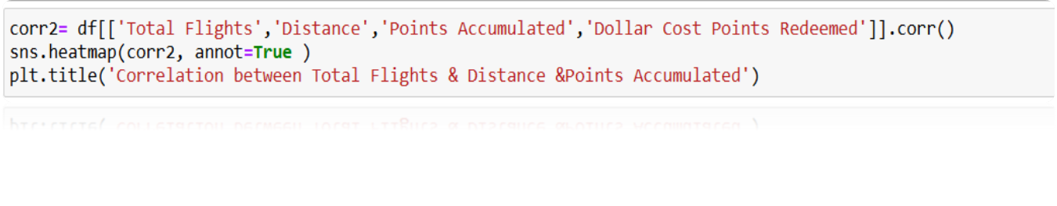
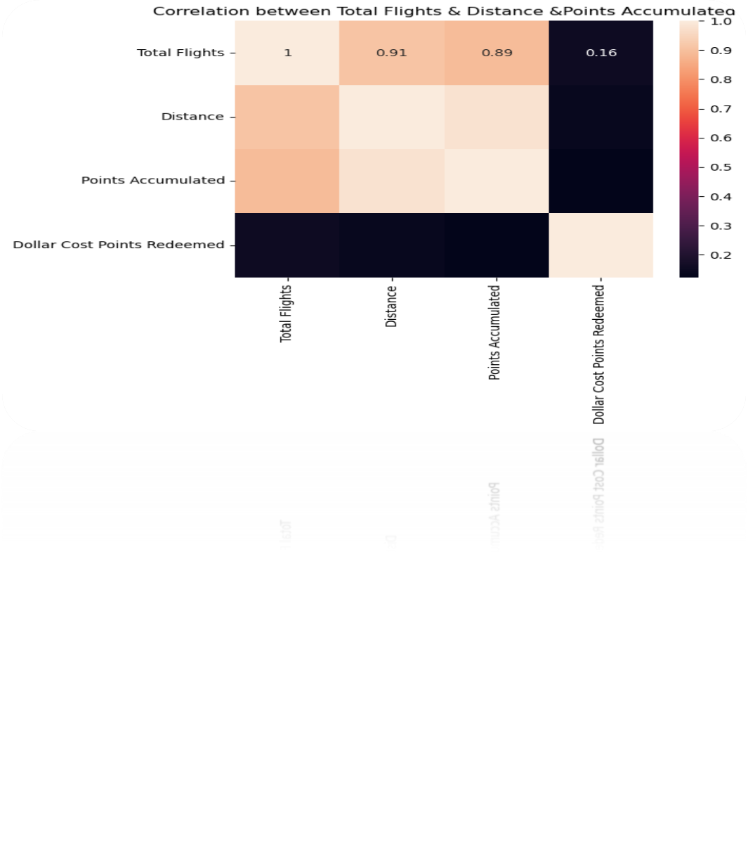

Slide 36
Transformation & Cleaning
Obtain both unambiguous tables.
Get accustomed to the different data types.
Perform data cleaning steps.
Conduct data transformation tasks.
Break down tables into simpler, more manageable parts.
Determine the connections between the tables.

Slide 37
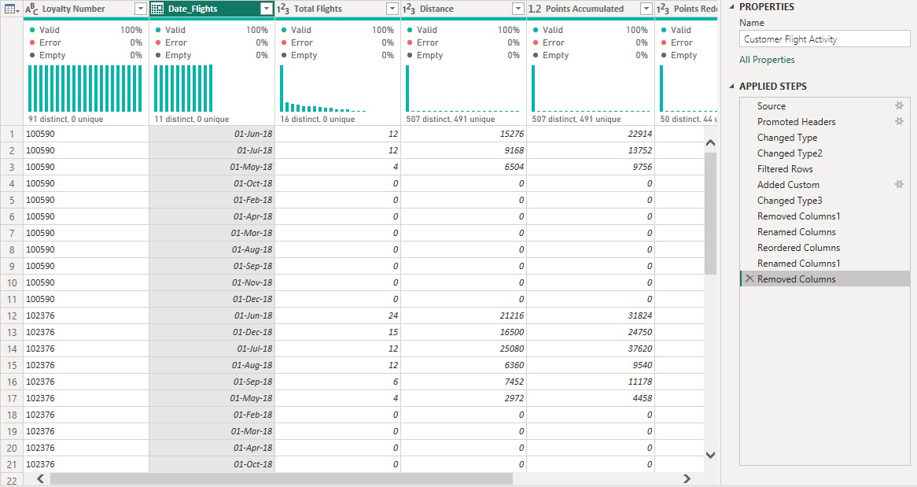

Slide 38
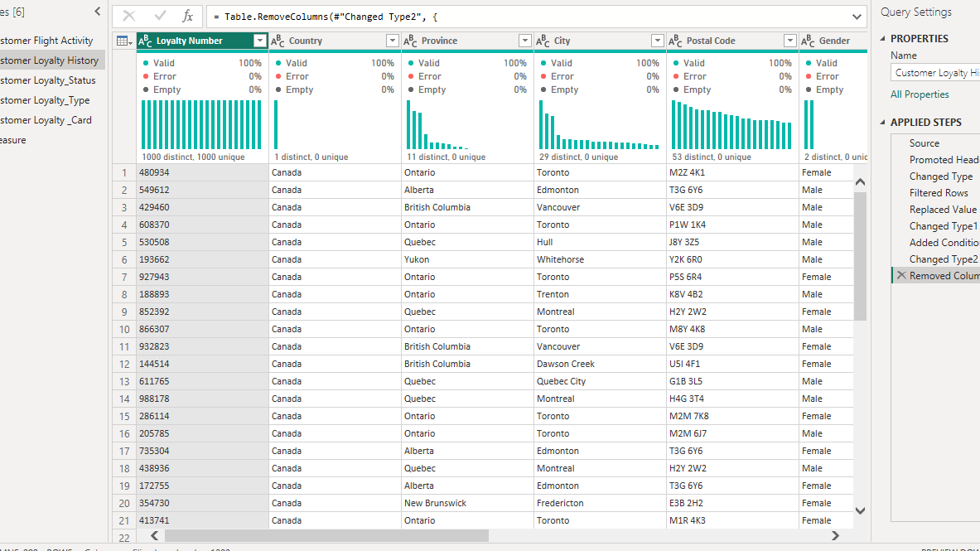

Slide 39
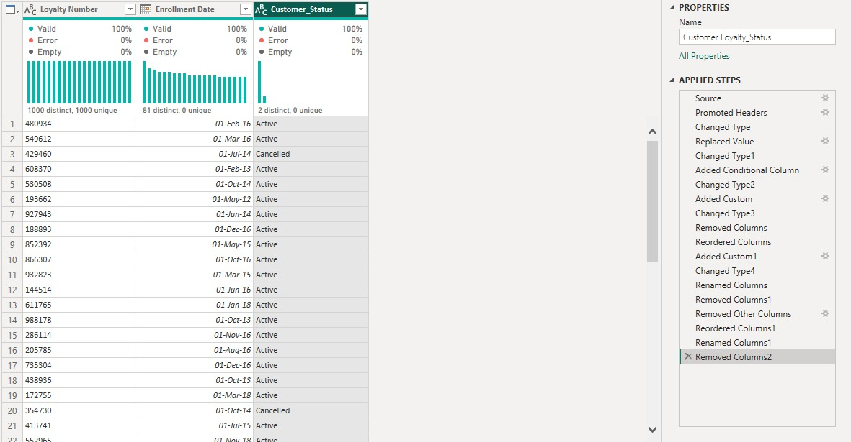

Slide 40
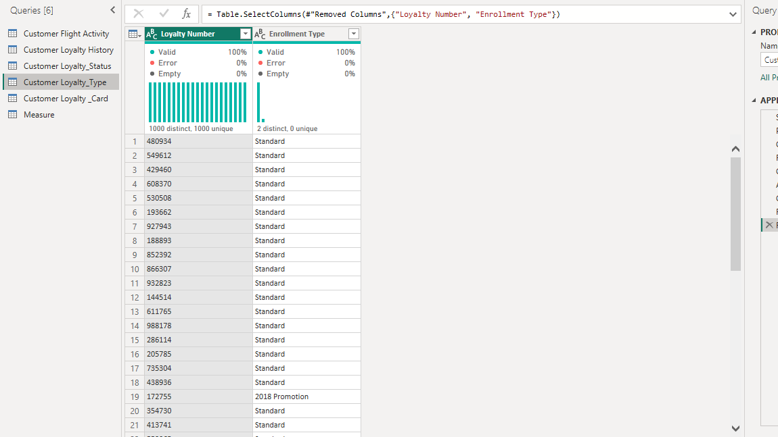

Slide 41
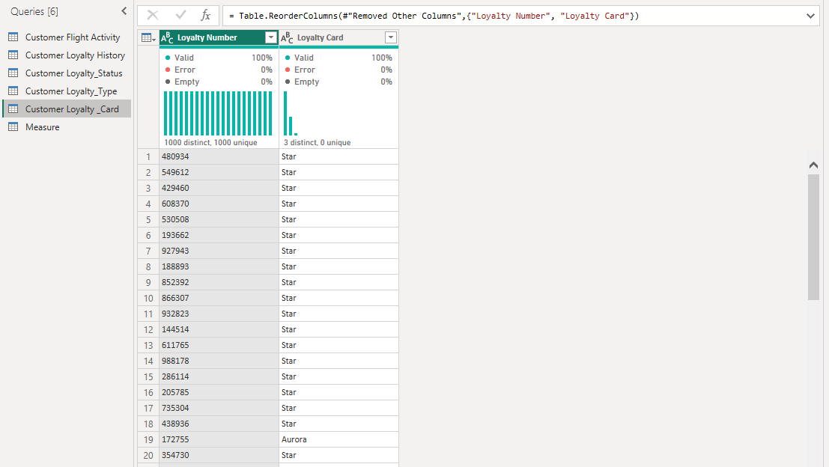

Slide 42
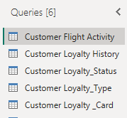
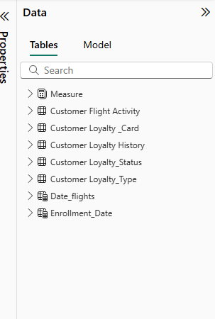

Slide 43
Data Modeling
Created a data-model diagram to visualize table structures.
Identified and defined the central fact table.
Established and configured key-column relationships across tables.

Slide 44

Data Model Overview
Central “Customer Flight Activity” table includes key metrics.
Dimension tables enhance contextual data.
Relationships established for data integrity.
Confirm hierarchies within dimensions.
Notes:
This slide provides an overview of the 'Orders' data model. The central table aggregates key metrics such as sales, cost, quantity, and profit, while dimension tables enrich the dataset with contextual information. It's vital to confirm the relationships and hierarchies within the dimensions and to establish clear naming conventions for better data management.

Slide 45
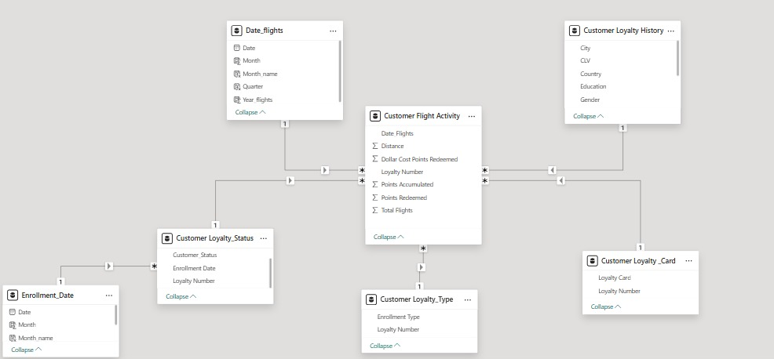

Slide 46
Fast Insights
Define key performance parameters
Using Power Pivot to Determine Relationships between Tables
Extract information from data

Slide 47
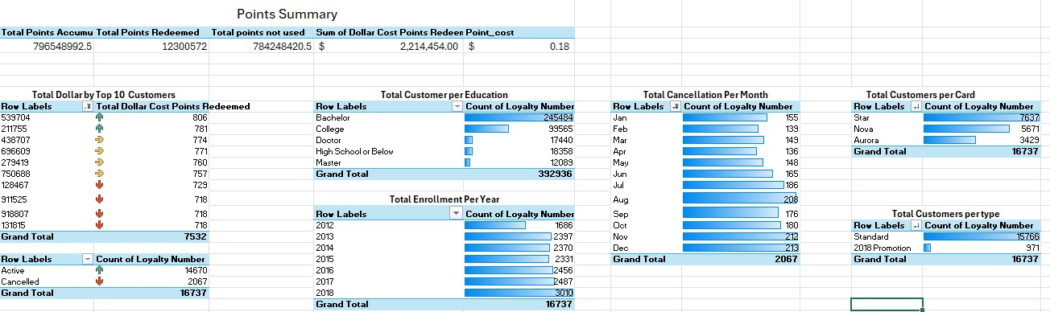

Slide 49
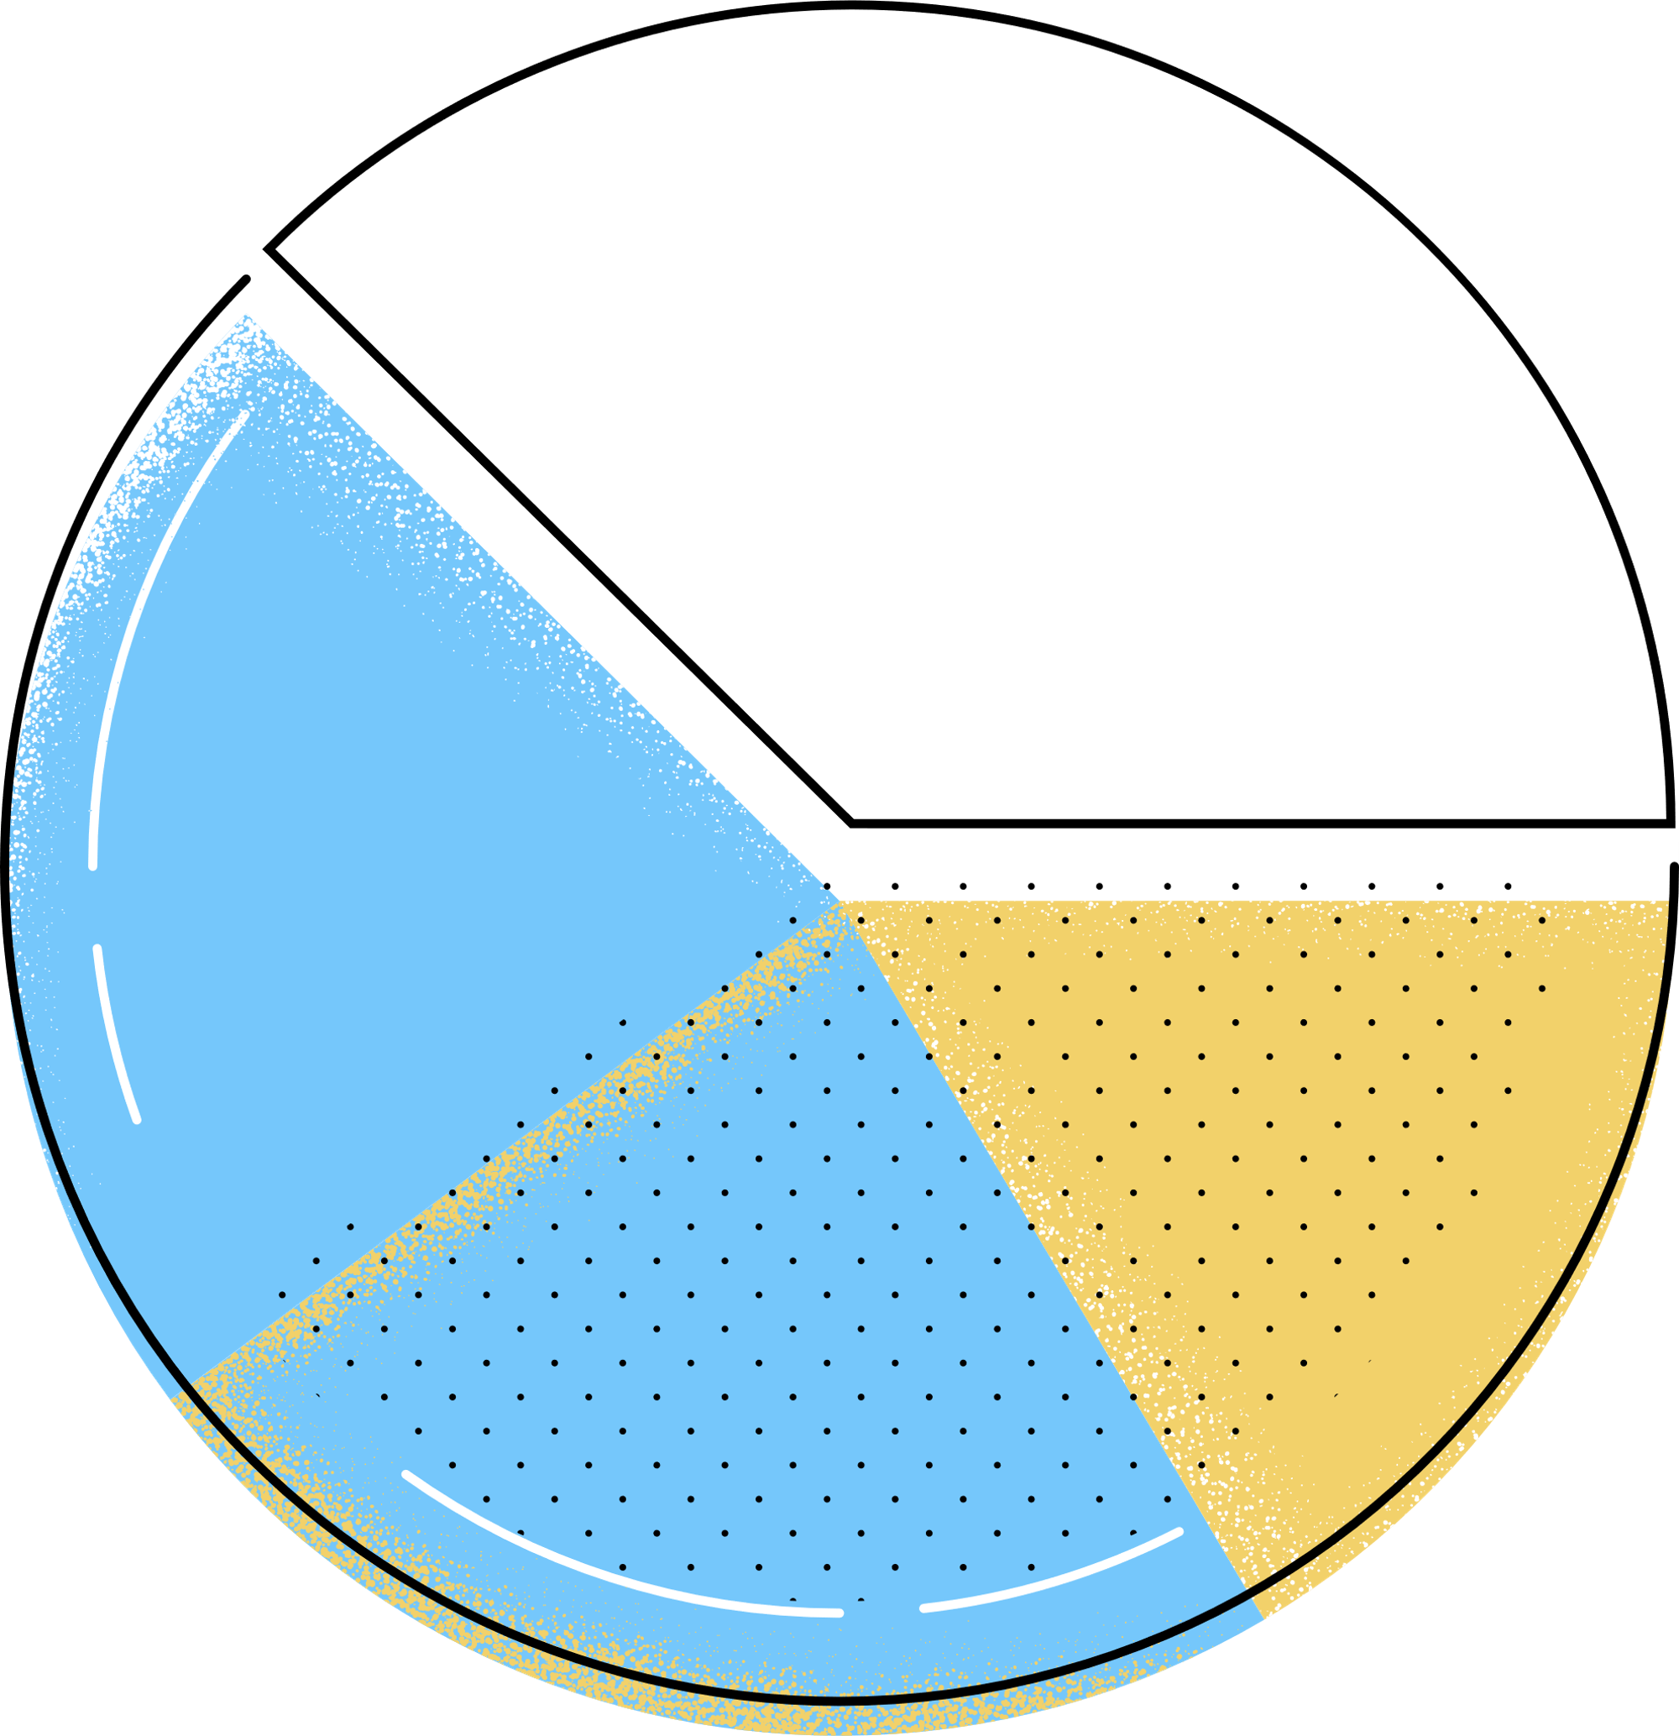
Dashboard
The Dashboard classify into:
Home page
Customer Dashboard
Status Dashboard
Total Flights
Points
Loyalty

Slide 50

Dashboard Sections
Home Page provides access to the Orders Dashboards
And Customer Dashboards
Customer Dashboard includes charts for Transactions trends.
Status Dashboard features RFM and retention graphs.
Total Flight Dashboard feauters Flights Trends.
Points & Loyalty Dashboards Feature Loyalty Insights.
Visuals include wireframes of the dashboard's layout.
Navigation menu displays user interaction options.
Notes:
This slide outlines the main sections of the dashboard. The Home Page will showcase key performance indicators, serving as a summary. Order and Customer Analysis will provide detailed insights through various charts. Additionally, the visual elements present a clear wireframe layout and navigation options, enhancing user experience.

Slide 51
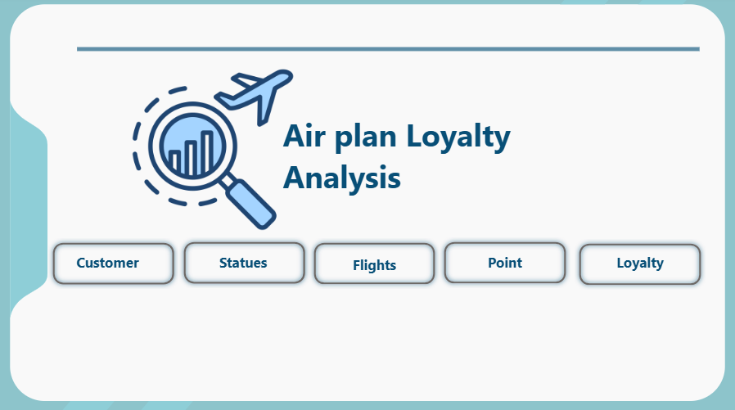

Slide 52


Slide 53


Slide 54


Slide 55


Slide 56


Slide 57
Tableau Dashboard

Slide 58


Slide 59


Slide 60

Actionable Insights
1 - Data Quality:
Investigate negative salaries and missing salary entries before modeling or segmentation.
2- Targeted Engagement:
Focus retention offers on customers approaching 1 year of membership, when cancellations spike.
Encourage under-engaged card tiers (e.g., non-Star members) to redeem points.
3- Segmentation:
Build CLV-driven segments to tailor promotions—top 5% CLV drives a disproportionate share of value.
4- Geographic Expansion:
Leverage high-density postal codes (e.g., V6E 3D9) for localized outreach or events.
5- Enrollment Optimization:
Analyze mid-year enrollment drivers; replicate successful channels in off-peak months.
Notes:
This slide presents key insights from our sales analysis. Notably, we observe a significant sales peak in the summer months, particularly in July 2017. The data indicates that Mountain and Electric bikes are major contributors to our sales figures. Additionally, a small number of top-performing stores drive a considerable portion of revenue, highlighting the importance of high-value customers in ensuring repeat business.

Slide 61

Recommendations & Next Steps
Notes:
This slide outlines actionable recommendations divided into short, mid, and long-term strategies. In the short-term, focusing on inventory and targeted promotions can address immediate sales needs. Mid-term strategies aim to enhance customer loyalty and optimize operational efficiency, while long-term initiatives focus on pricing strategies and expansion opportunities.

Slide 62

1. Data Quality Enhancement
Audit salary data
Identify and correct negative values
Standardize formats (no commas, consistent currency)
Address missing salaries
Impute using median by education level or geography
Flag remaining gaps for manual follow-up
Establish validation rules
Prevent future entry of negative or null salaries
Automate quality checks in Power Query or Python

Slide 63

2. Targeted Engagement Campaign
-Build an “At-Risk” cohort
Filter customers with 10–11 months of tenure
Score by recent activity and points balance
-Design retention offers
Bonus points if they transact before 12-month mark
Exclusive discount or partner perk
-Deploy multi-channel outreach
Personalized emails with countdown messaging
SMS reminders for high-value, mobile-opted customers
-Measure success
Track cancellation rate among campaign vs. control
Monitor redemption and incremental spend lift

Slide 64

3. CLV-Driven Segmentation & Personalization
Define CLV segments
Top 5% (high value)
Next 15% (growth opportunity)
Remaining 80% (maintenance/reengagement)
Craft tailored offers
Tier 1: VIP events, extra-tier upgrades
Tier 2: Bonus-point boosters, referral incentives
Tier 3: Welcome-back discounts, educational content
Automate in CRM or Power Automate
Trigger campaigns based on segment membership
Refresh segments monthly
KPI tracking
Segment-level revenue growth
Shift in CLV distribution over time

Slide 65

4. Geographic Expansion Pilot
Identify top 3 high-density postal codes (e.g., V6E 3D9)
Plan localized initiatives
Pop-up events or partner promotions
Geotargeted digital ads
Test and learn
Use A/B testing in two comparable regions
Measure foot traffic lift, enrollments, redemption rates
Scale successful tactics to other clusters

Slide 66

5. Enrollment Optimization Strategy
Analyze enrollment channels by month
Compare mid-year peaks vs. off-peak performance
Develop off-peak campaigns
Referral bonuses for current members
Limited-time sign-up incentives
A/B test messaging and channels
Social media vs. email vs. in-app prompts
Optimize on conversion rate and cost per acquisition
Iterate quarterly based on results

Slide 67

6. Dashboarding & Reporting
Build a live dashboard in Power BI or Tableau
Key metrics: enrollments, cancellations, CLV distribution, segment performance
Automate weekly snapshot reports
Use Power Automate + Excel to push summaries to stakeholders
Set alert thresholds
E.g., cancellation rate > 15% in a month triggers review

Slide 68

7. Governance & Continuous Improvement
Establish a monthly review forum
Evaluate campaign KPIs, data-quality trends, segmentation shifts
Refine tactics
Rotate offers, adjust thresholds, expand geography
Schedule bi-annual data refresh
Recompute CLV, retrain any predictive models, update cohorts

Slide 69

Projected Impact & ROI
Notes:
This slide outlines the anticipated financial benefits of the initiative. The projected uplift in revenue signifies the effectiveness of optimized inventory strategies. Additionally, improvements in margins through targeted promotions can enhance profitability. Cost savings from reduced stockouts play a crucial role in overall efficiency, and the payback period highlights the quick return on investment.

Slide 70

1. Data Quality Enhancement
-Benefit
Saves ~500 hours of manual correction (at $50/hour) = $25,000
Avoids modeling errors (estimated cost avoidance) = $40,000
Total benefit = $65,000
-Cost
Automation tooling & scripts = $10,000
Team time (100 hours @ $50/hour) = $5,000
Total cost = $15,000
-Net benefit = $50,000
-ROI = (50,000 / 15,000) ≈ 333%

Slide 71

2. Targeted Retention Campaign
-Baseline churn = 12.4% of 16,737 = 2,077 customers
-Goal = 20% churn reduction → saves ~415 customers
-Benefit = 415 × $7,989 = $3,320,000
-Cost
Campaign design, creative, channel spend = $200,000
-Net benefit = $3,120,000
-ROI = (3,120,000 / 200,000) = 1,560%

Slide 72

3. CLV-Driven Segmentation
-Top 5% segment = ~837 customers
-Uplift target = 10% additional spend on this group
-Avg. CLV for top segment (assumed) = $12,000
-Incremental benefit = 837 × ($12,000 × 10%) ≈ $840,000
-Cost
Data modeling, personalized content = $80,000
-Net benefit = $760,000
-ROI = (760,000 / 80,000) = 950%

Slide 73

4. Geographic Expansion Pilot
-Pilot in 3 high-density postal codes
-Estimated net new enrollments = 100 customers
-Benefit = 100 × $8,000 (assumed CLV) = $800,000
-Cost
Local events + targeted ads = $120,000
-Net benefit = $680,000
-ROI = (680,000 / 120,000) ≈ 567%

Slide 74

5. Enrollment Optimization
-Off-peak uplift = 10% on 15,766 standard enrollments = 1,577 new members
-Benefit = 1,577 × $7,989 ≈ $12,600,000
-Cost
Incentives, referral program, marketing = $300,000
-Net benefit = $12,300,000
-ROI = (12,300,000 / 300,000) = 4,100%

Slide 75

Consolidated Summary
-Total Impact
Combined Benefit: $17.63 million
Total Cost: $715,000
Net Gain: $16.91 million
Overall ROI: 2,365%

Slide 76

Questions & Next Steps
Thank you—happy to take your questions.
-Key contacts for follow-up: Are
Ahmed Mohamed El-saeed ahmedmohamedelsaeed217@gmail.com
Mohamed Hossam
mohamed.hossam.mh01@gmail.com
Youssef Ali
Ya743231@gmail.com
Youssef Mohamed
youssefazoz2017@gmail.com
Notes:
This slide invites the audience to engage with questions and provides key contact information for follow-up. Emphasize the importance of feedback in refining the dashboards, and encourage attendees to utilize the space provided for live note-taking or capturing action items during the discussion.

